Slide 1

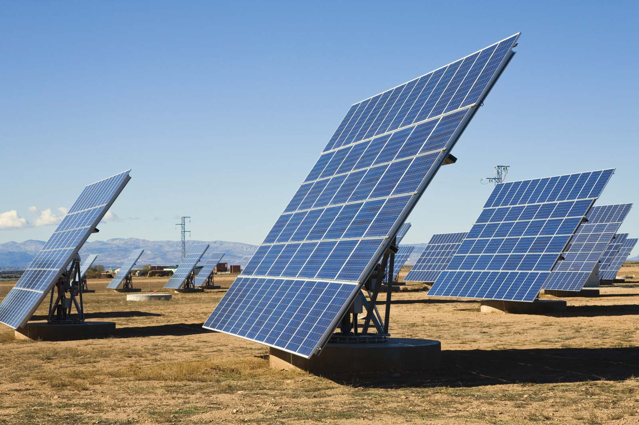
DUAL AXIS SOLAR TRACKER
PRESENTED BY
ADITYA SHAH (Roll:2011mt02)
Department of Mechatronics
For the Academic Year 2020 - 2021

Slide 2

CONTENTS
INTRODUCTION
NEED OF THE PROJECT
MATHEMATICAL MODEL OF THE PV ARRAY
SOLAR TRACKER TYPES
APPARATUS
WORKING PRINCIPLE
BLOCK DIAGRAM OF SOLAR TRACKER
RESULTS
FUTURE SCOPE
REFERENCE

Slide 3
INTRODUCTION
Why Solar Energy?
Easily Accessible.
Pollution FREE.
Available in infinite quantity.
The natural gift like fossil fuels, woods, etc. are limited in amount.
Increasing demands for energy day by day.
Growing concern regarding environmental pollution.
Renewable sources such as solar and wind power are popular today.
Solar energy provides great prospect for conversion into electrical power, which in turn ensures need of increasing energy demand.
Photovoltaic (PV for short) is the conversion principle employed in conversion of solar light into electricity.
PV panels system is only about 24.5% efficient.

Slide 4
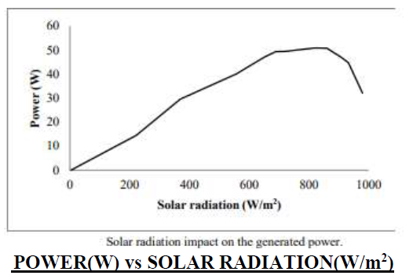
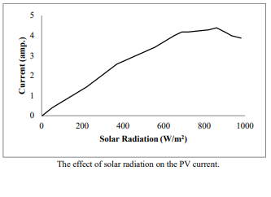
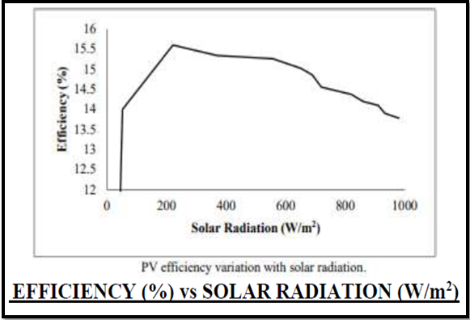

NEED OF THE PROJECT
CURRENT(A) vs SOLAR RADIATION(W/m²)
DL 9032 solar system(a module of (85 W, 12 V).)
SO,WHAT WE OBSERVE,
variations in the output power, current and efficiency with solar radiation.
PROBLEM STATEMENT :
The problem with fixed solar panels is that their orientation cannot adjust according to the change in position of the Sun. Hence the panel can’t get the direct rays from Sun. So it cannot receive the maximum intensity of sunlight which reduces the output of the solar panel.
AND WHAT WE INFER,
dual axis solar tracker is essential for operating the solar at higher efficiency and higher power output.
So that we have an optimal output from solar cell used.
Solution :
The solution thus includes implementation of a system (solar tracker)that is capable of adjusting its position according to maximum intensity of light falling perpendicular to it.

Slide 5
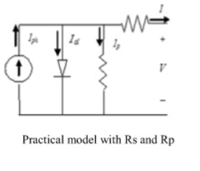
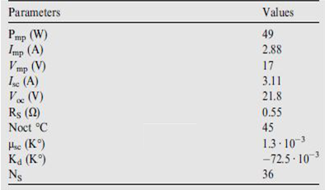
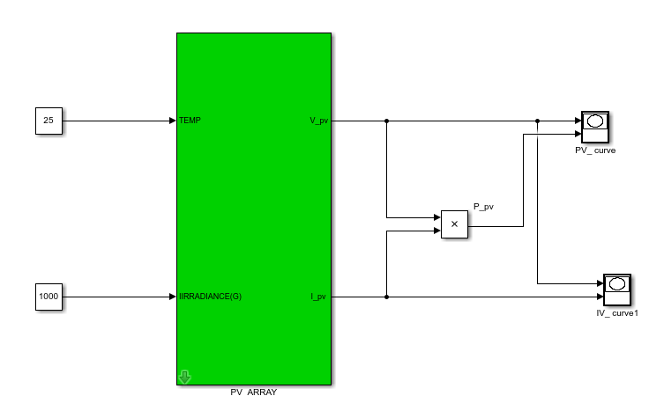





Mathematical model of the PV Array
Detailed modeling of the effect of irradiance and temperature on the parameters of the PV module.
Chosen model is the single diode model with both series and parallel resistors
I_{ph} is the photocurrent
μ_{SC} : Coefficient temperature of short circuit current (A/K)
I_{d} is the diode current given by
I_{ph,ref} : Photocurrent (A) at STC.
A is the ideality factor
G: Irradiance (W/m²)
I₀ is the reverse saturation or leakage current of the diode
G_{ref} : Irradiance at STC = 1000 W/m²
Ns: is the number of PV cells connected in series
T_{c,ref}:Cell temperature at STC = 25 + 273 = 298 K
a is called the modified ideality factor given by
D = diode diffusion factor
ɛ_{G}: Material band gap energy (eV),
T_{c} is the actual cell temperature (K)
Output current of a module containing N_{s} cells in series will be:
By applying Kirchhoff law,

Slide 6
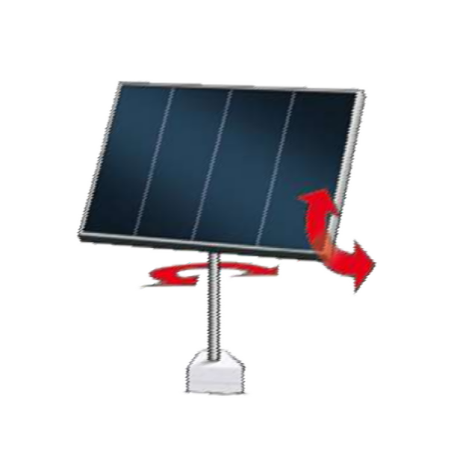
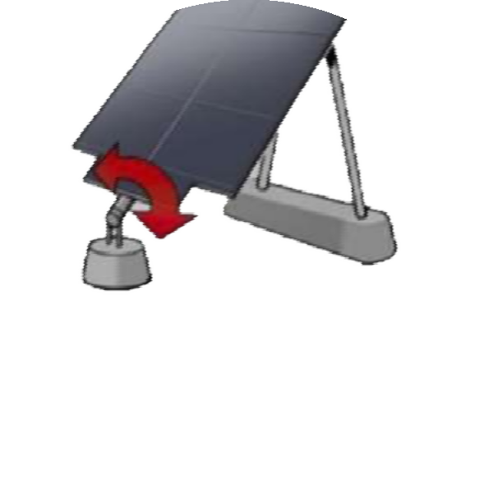
1.2 TYPES OF SOLAR TRACKER:-
SINGLE AXIS TRACKER:-
DUAL AXIS TRACKER:-
1 .3 APPARATUS:-
Light Sensor Theory and Circuit of Sensor Used: Light detecting sensor that maybe used to build solar tracker include; phototransistors, photodiodes, LDR and LLS05. A suitable, inexpensive, simple and easy to interface photo sensor is analog LDR which amongst the light sensors is the most common in electronics. It is usually in form of a photo resistor made of Cadmium Sulfide (CdS) or Gallium Arsenide (GaAs).
DC/Servo Motor and Driver And Feedback Sensor: A 9 Volts DC motor (10RPM) and L293D Motor Driver.
Microcontroller: The Arduino Uno is an open-source microcontroller board based on the Microchip ATmega328 P microcontroller and developed byArduino.cc .
Solar Panel: Sandro (BPL) make, Model no: 1.8W-5V 180*90, Pmax=1.8W,Vmp=5V .

Slide 7
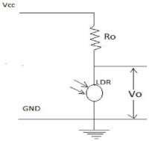
1.4 Working Principle:-
The microcontroller then analyse the ADC o/p and the motor position then can be controlled by this mechanism .
The tracker finally adjusts its position sensing the max. intensity of light falling perpendicular to it and stays there till it notices any further change.
A potential divider circuit is used to get the output voltage from the sensors (LDRs).
Voltage across LDR is converted to a digital signal via ADC which generally ranges from 0 to1023.
Resistance of LDR depends on intensity of the light and it varies according to it. The higher is the intensity of light, lower will be the LDR resistance which lowers the output voltage and vice versa.
FIG 6

Slide 8
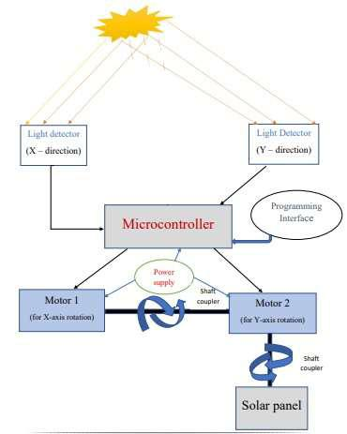
1.5 Block Diagram of Solar Tracker:-
FIG 7

Slide 9
RESULTS
PROTOTYPE
AUTOCAD DESIGN
3D CAD DESIGN
WHAT WE HAVE OBSERVED…
When source light falls on the panel, the panel adjusts its position ,according to maximum intensity of light falling perpendicular to it.
The objective of the project is achieved using a system with three stages:
An input stage that was responsible for converting incident light to a voltage.
A control stage that was responsible for controlling actuation and decision-making.
A driver stage with the DC motor. It was responsible for actual movement of the panel.

Slide 10
FUTURE SCOPE
In this era of digital world, the tracking systems can be redesigned without the dependency on photosensor/LDRs.
It includes finding the position of the Sun w.r.t earth geographical location using astronomical data by softwares, using cloud services and microcontrollers to communicate the position to tracking system.
The position of the Sun in the sky is a function of both the time and the geographic location of observation on Earth's surface. The solution is:
SOLAR TRACK APP and ASSOCIATED TRACKING HARDWARE

Slide 11
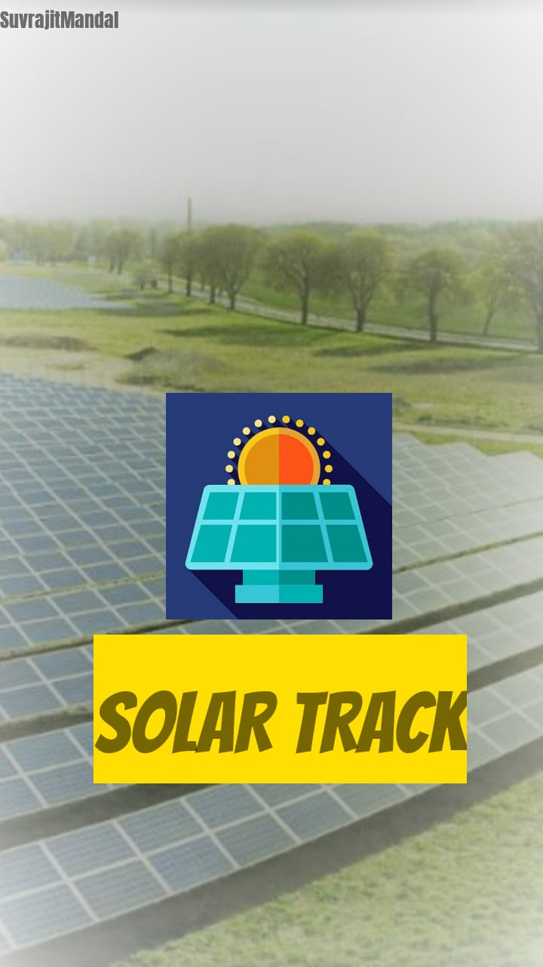
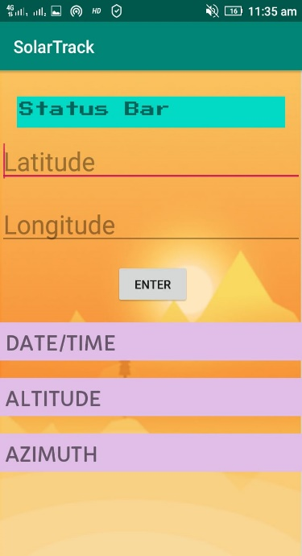
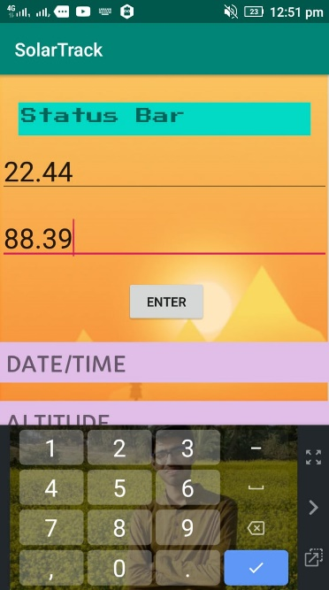
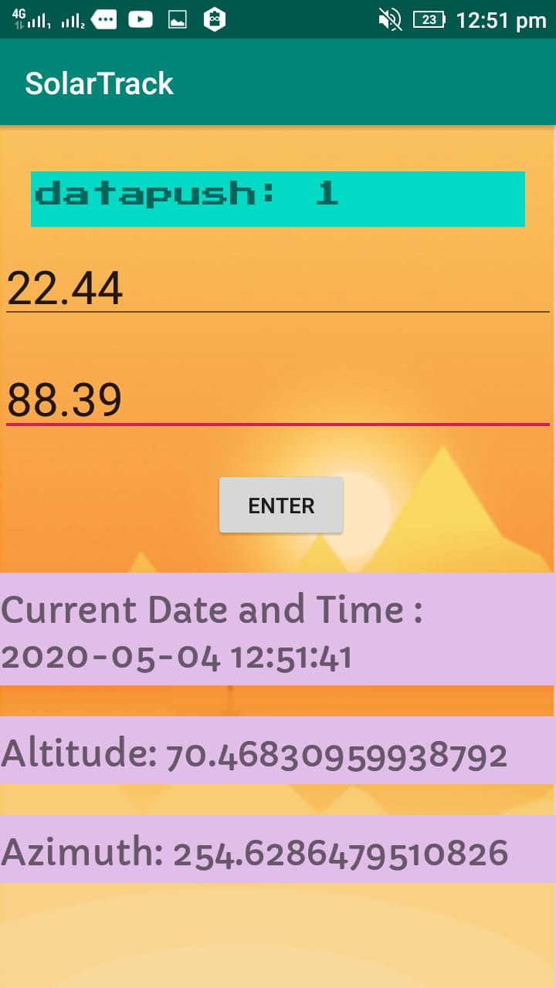
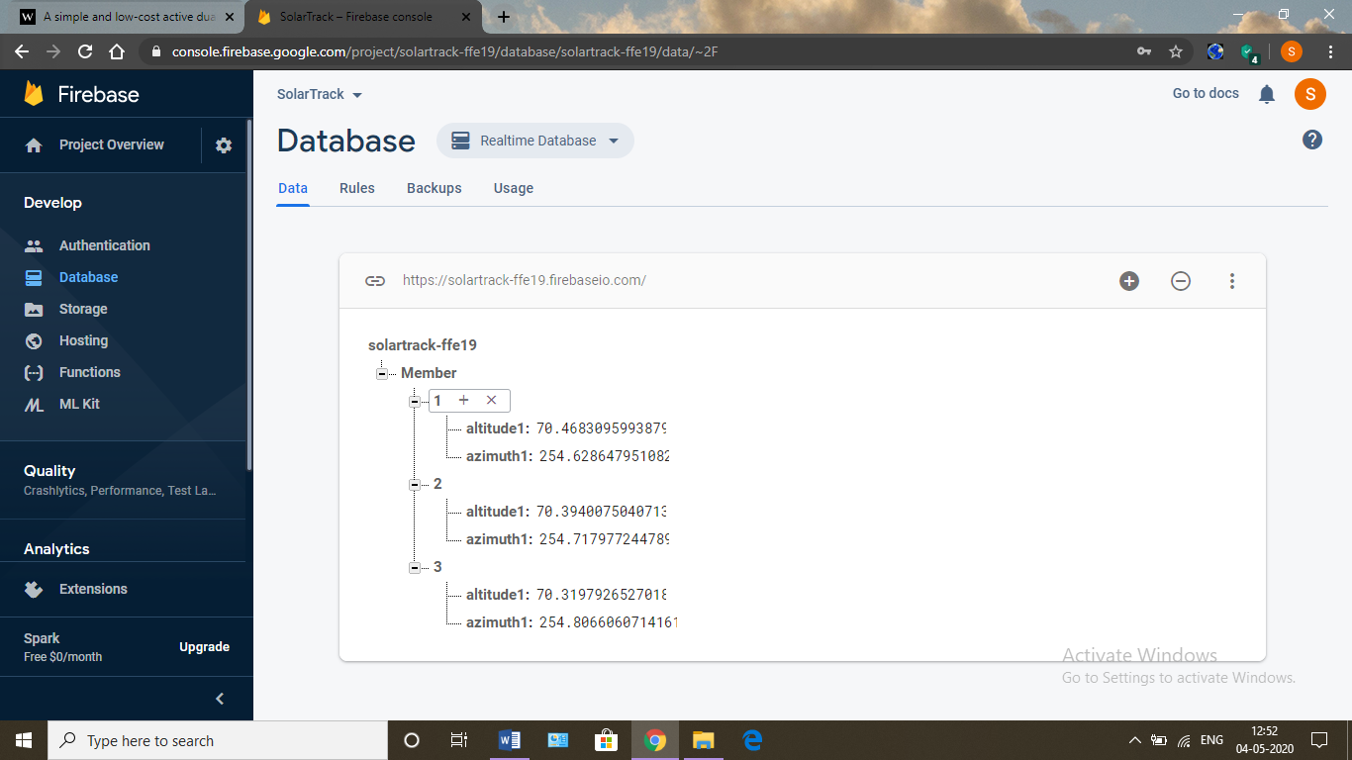

ARDUINO NODEMCU, STEPPER MOTOR , MOTOR DRIVE MODULE, PANEL

Slide 12
REFERENCE
Solar Tracking. Prinsloo GJ, Dobson RT. 1st ed. Stellenbosch: Solar Books, 2016. ISBN 978-0-620-61576-1. doi: 10.13140/2.1.2748.3201.
Wang, Jing-Min & Lu, Chia-Liang. (2013). Design and Implementation of a Sun Tracker with a Dual-Axis Single Motor for an Optical Sensor-Based Photovoltaic System. Sensors (Basel, Switzerland). 13. 3157-68. 10.3390/s130303157.
Sensors And Transducers, Second Edition by D. Patranabis,Edition,2nd edition, Binding, Paperback, ISBN 13-9788120321984,ISBN 10-8120321987.
Journal NRIAG Journal of Astronomy and Geophysics Volume 3, 2014 - Issue 1
Utilization of Electrical Power Paperback – 1 January 2016, by Er. R.K. Rajput Paperback: 741 pages, Laxmi Publications; Second edition (2016),Language: English,ISBN-10: 8131808297,ISBN-13: 978-8131808290.
Arduino Programming Notebook, Brian W. Evans, Publisher: Lulu.com (September 10, 2008), License(s): Creative Commons BY-SA, Paperback 36 pages, Language: English, ASIN: B002AD5Q8Q, ISBN-13: N/A.
International Research Journal of Advanced Engineering and Science, Jammu: IRJAES, Language: English Country: India, ISSN (Online): 2455-9024

Slide 13
THANK YOU

